Slide 1
Street sign image segmentation
CMPS 473 / Computer Vision
by Brooks Schafer

Slide 2
Problem:
Street view images contain many elements that can make it difficult for a computer to extract meaningful information from street signs.
Goal:
Develop a computer vision application using Python to perform segmentation of street signs in street view images for further processing.

Slide 3
techniques used:
Thresholding
K-Means Clustering
3

Slide 4
General Process:
Load and preprocess the image
Create a binary mask representing pixels that contain the sign
Clean the binary mask
Apply the cleaned mask to the original image
4

Slide 5
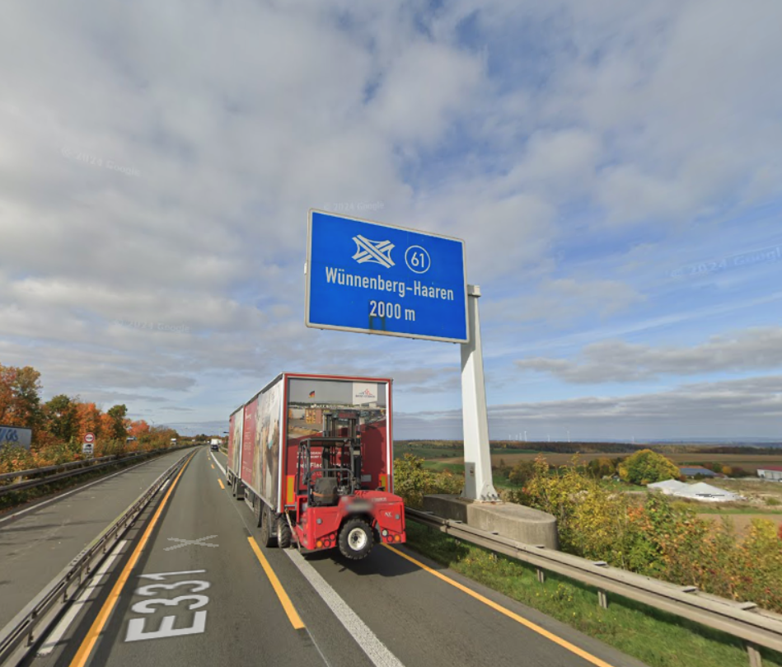
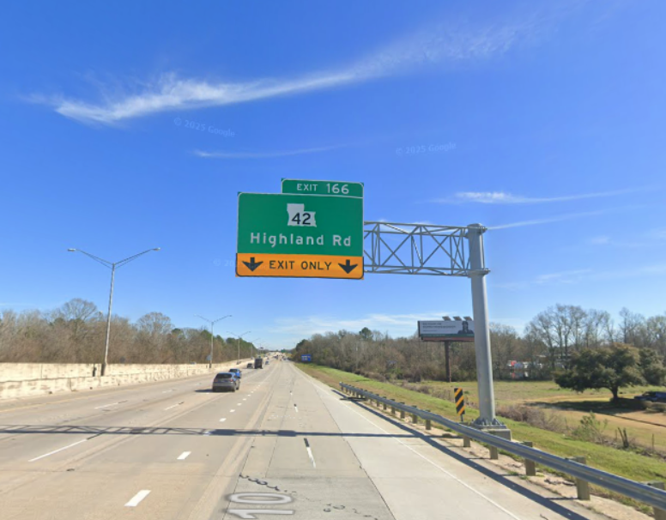
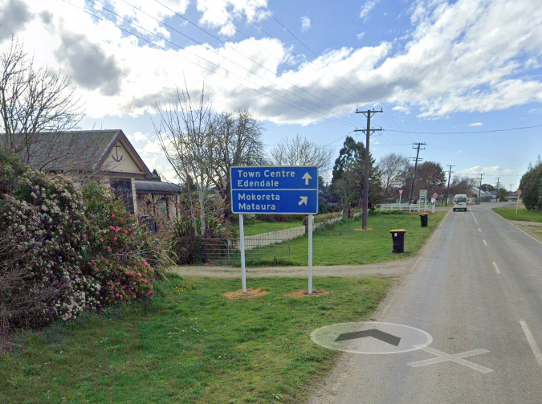
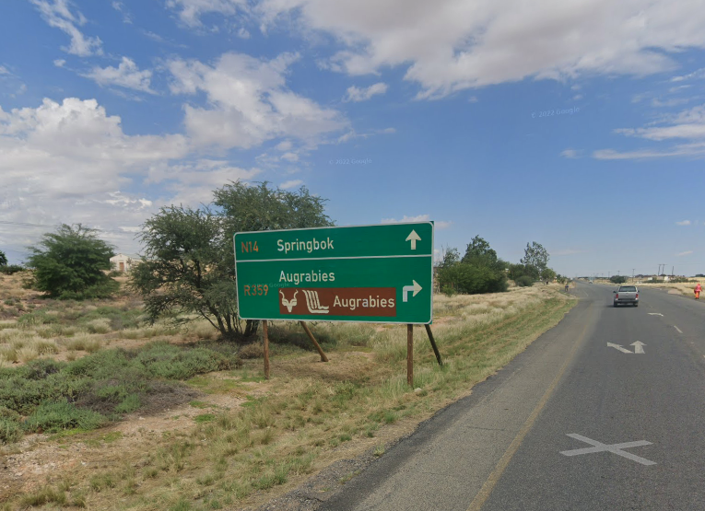
Example Input images:
Source: Google Street View

Slide 6
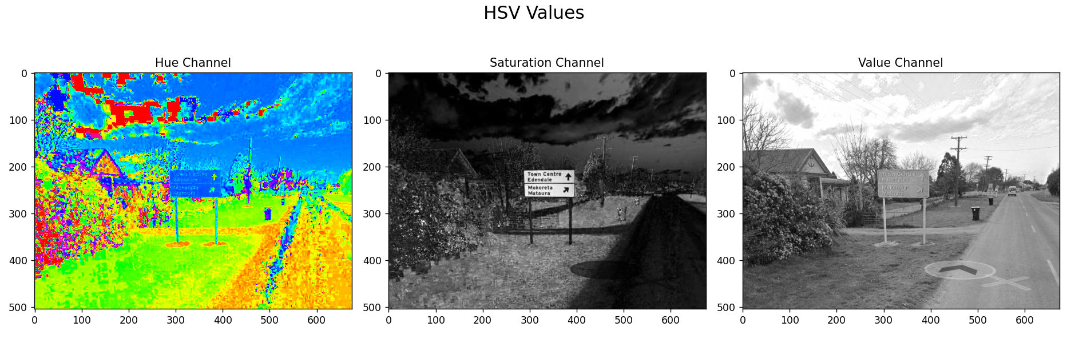
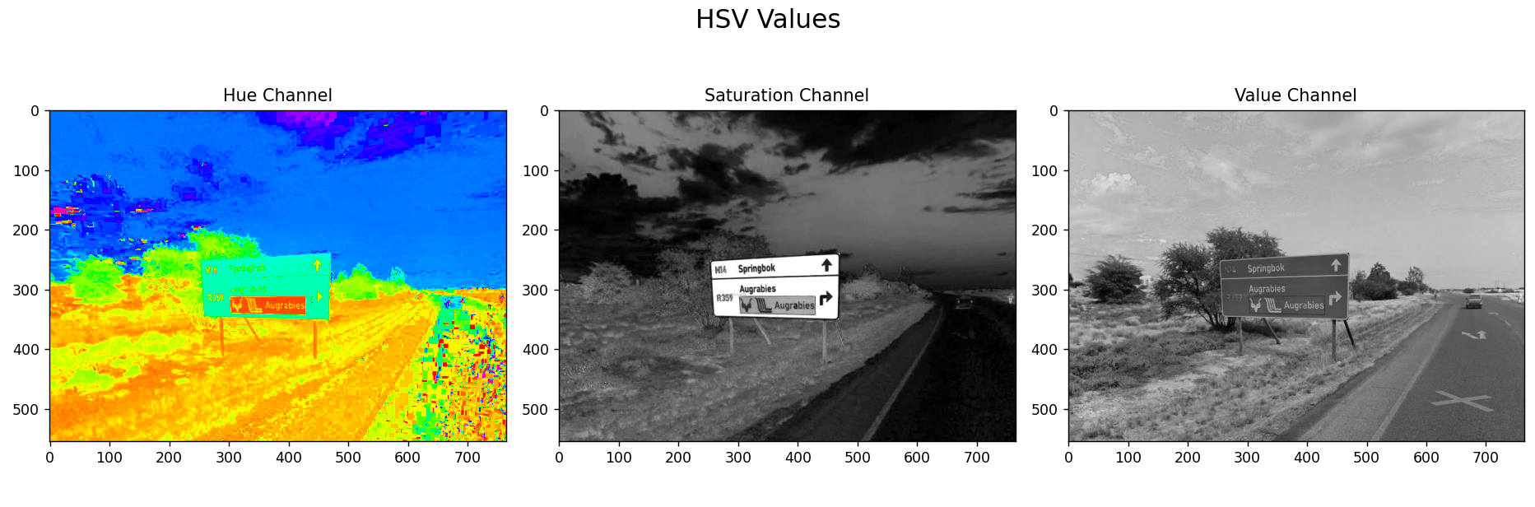
Preprocessing:
Convert from RGB to HSV
Why HSV? Better for segmentation based on color

Slide 7
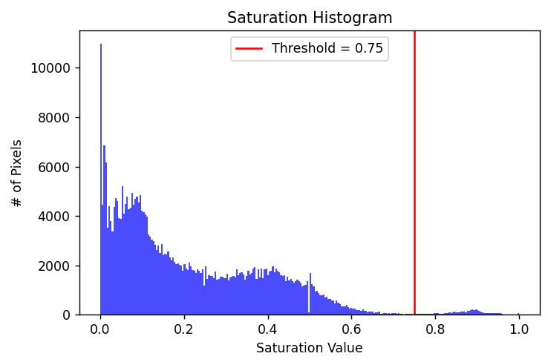
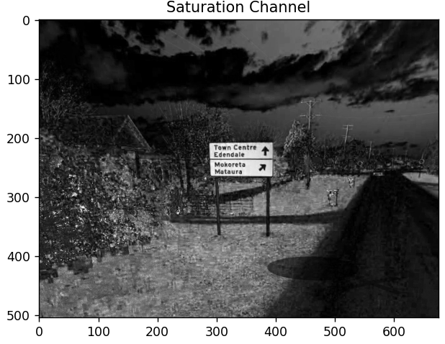
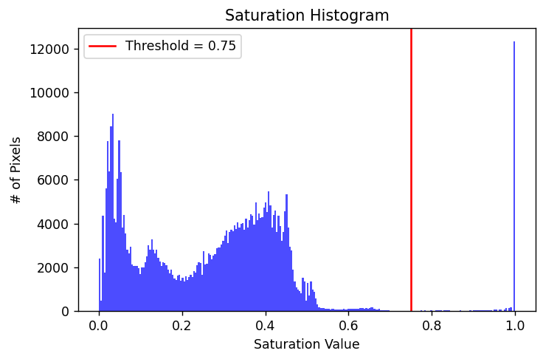
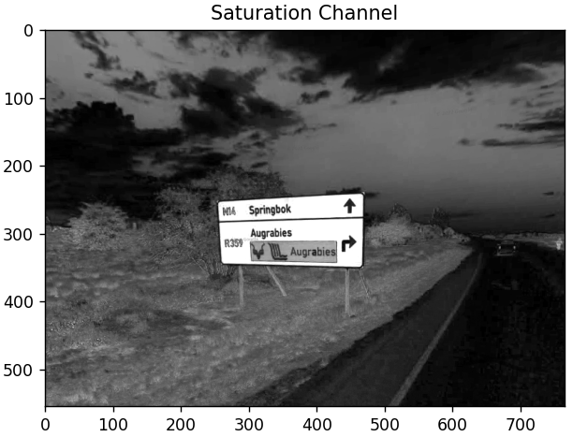
Thresholding:
binaryMask = s > threshold

Slide 8
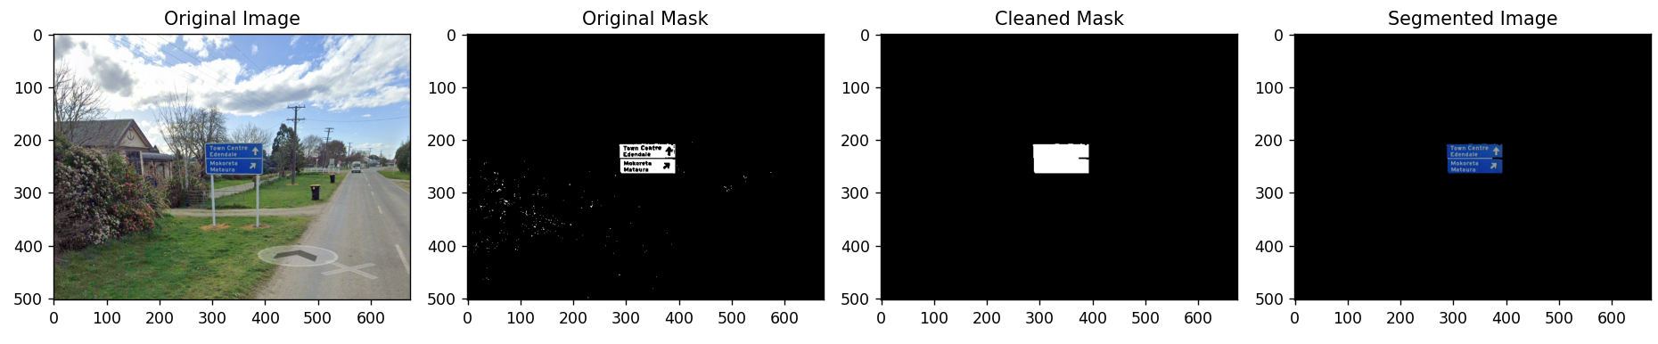
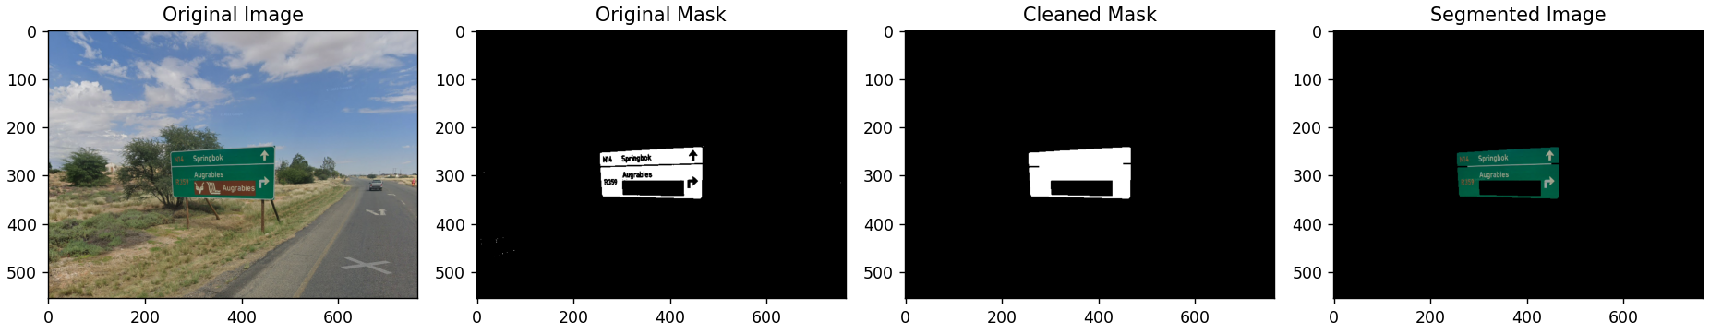
Thresholding Results:

Slide 9
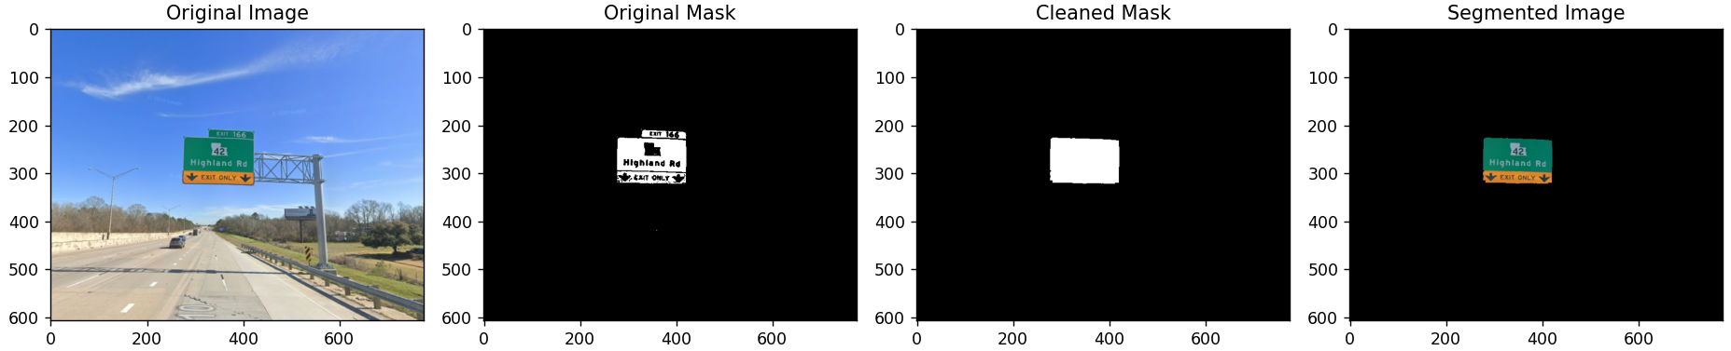
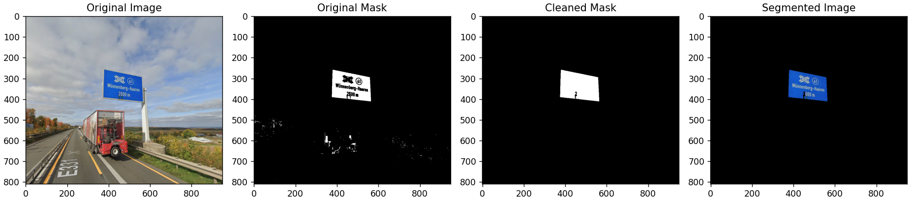
Thresholding Results:

Slide 10
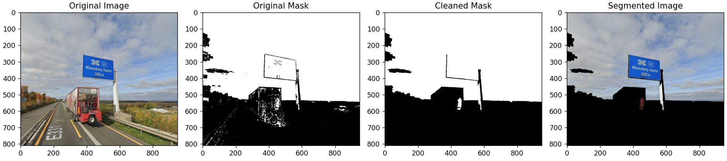
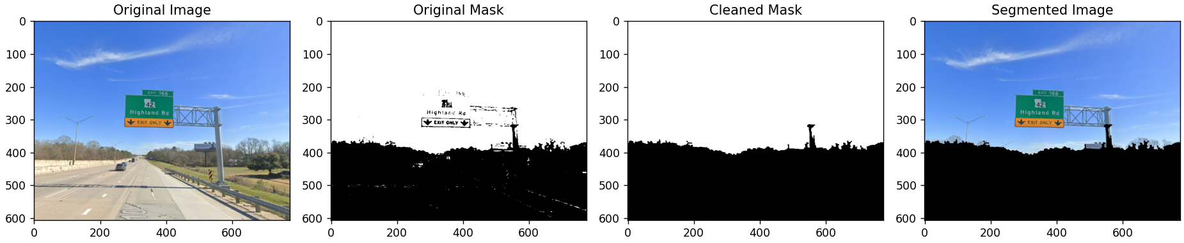
K-Means clustering (k=2):
kMeans = KMeans(n_clusters=2, n_init=10)
kMeans.fit(newImg)
binaryMask = (kMeans.labels_ == 1)

Slide 11
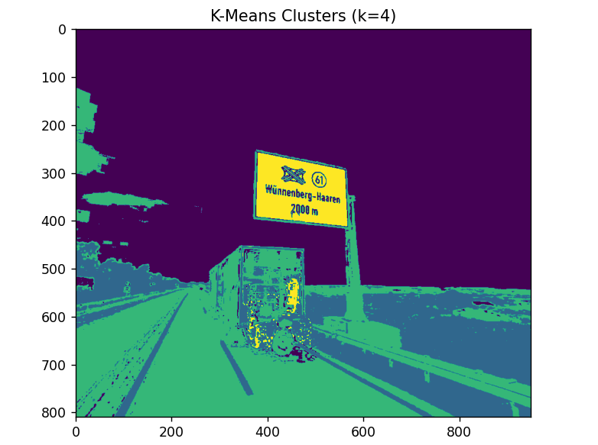
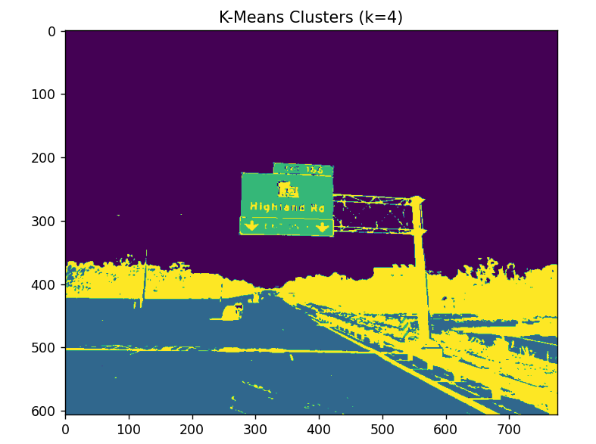
K-Means clustering (k=4):
Idea:
Apply KMeans model with 4 clusters to image
Choose smallest cluster to represent the sign
kMeans = KMeans(n_clusters=4, n_init=10)
kMeans.fit(newImg)
clusteredImg = kMeans.labels_
uniqueLabels, counts = np.unique(labels, return_counts=True)
smallestCluster = uniqueLabels[np.argmin(counts)]
binaryMask = (labels == smallestCluster)
11

Slide 12
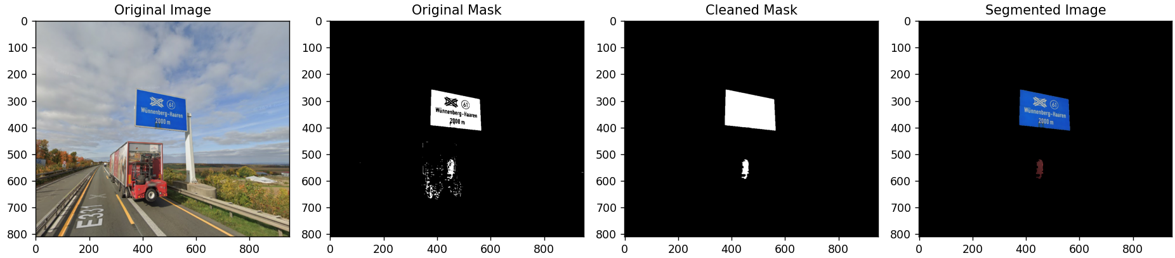
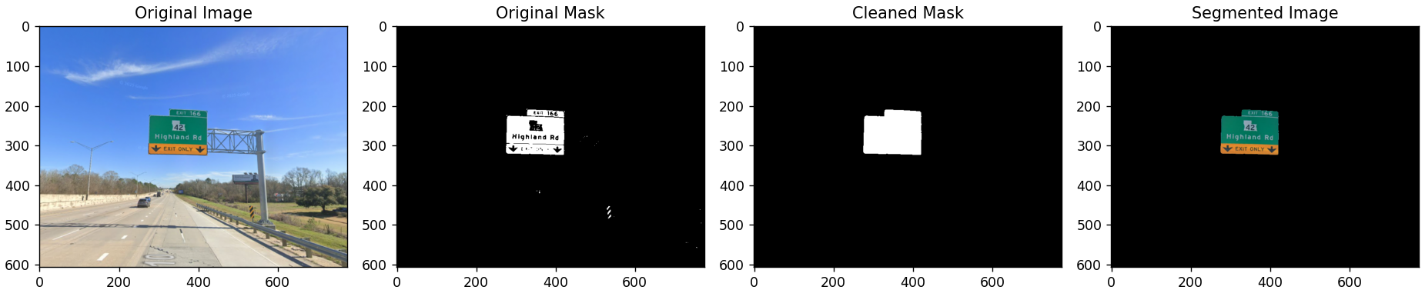
K-Means results:

Slide 13

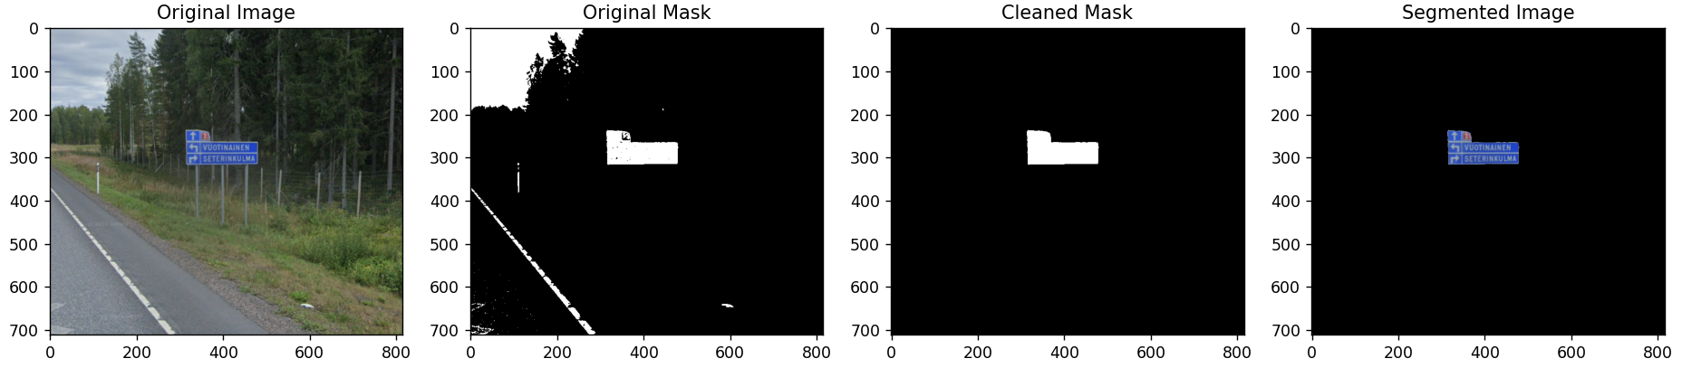
K-Means results:

Slide 14
Conclusion:
Thresholding and K-Means both produced decent results with minimal processing
Produces poor results in crowded urban areas with many signs
The project could be improved with more complex algorithms
Applications:
Autonomous driving systems
Mapping and navigation services

